Slide 1
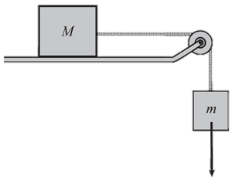
Write here the triangle to calculate force, mass and acceleration
Newton’s Laws
Write here the triangle and equation to calculate weight, mass and gravity
What are the units for Force?
Define Inertia
Define Newton’s First Law
Example:
Look at the practical below
1. The hanging mass m is 1kg. What is the force pulling along the block M?
2. Block M has a mass of 3 kg. Using your answer from question 1 and assuming that there is no friction calculate the acceleration of the block M.
Define Newton’s Second Law
Example:
Define Newton’s Third Law
Example:

